Slide 1
The Role of Application Layer Protocols in Modern Networked Applications
Name : Banu Werma Khallepalli(bk396),
jnana Harshavardhan Pechetti(jp2334)
New jersey institute of technology
Moshiur rahman
Date : 04/06/2024

Slide 2
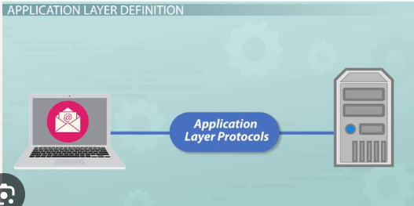
Introduction
This research presents a comparative analysis of application layer protocols, examining their roles in digital communication.
Protocols like HTTP, FTP, and SMTP are critical in managing diverse network activities and their evolutionary roles in digital landscapes.
Code snippets are used to illustrate practical applications, enhancing understanding of protocol functionality.
Findings highlight a complex interplay between efficiency, security, and scalability, indicating future directions for protocol development.

Slide 3
OBJECTIVES OF THE RESEARCH
To understand the significance of application layer protocols in network communication.
To analyze the impact of these protocols on the functionality and performance of networked applications.
To identify challenges and limitations in current protocol designs and their implementation.

Slide 4
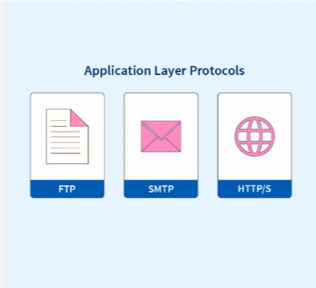
Problem Statement
Application layer protocols face significant challenges that impact the performance and reliability of networked applications.
The evolution of cyber threats and increasing demands for data throughput put these protocols under considerable strain (Yadav, 2023).
Identifying and addressing these challenges is crucial for the sustainability and advancement of network applications (Yadav, 2023).
Engineering resilient and robust networking solutions is imperative, beyond academic interest, to meet these growing demands.

Slide 5
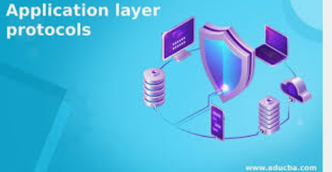
Significance of the Research
The research provides key insights into optimizing digital communication through application layer protocols.
Findings aid developers and network engineers in enhancing protocol performance for reliable and efficient networks.
Reveals the dynamic relationship between protocol design and functionality, critical for network infrastructure.
Acts as a guide for strategic decision-making in the progressive development of networking systems.

Slide 6
Chapter 2 - Literature Review Overview
HTTP: The Cornerstone of the Web
FTP: The Stalwart of File Transfer
HTTP has been fundamental to the World Wide Web since its creation by Tim Berners-Lee in 1989 (Walden, 2022).
Chronicles HTTP's evolution from HTTP/0.9 to HTTP/2, and the emerging HTTP/3 for enhanced web communication.
Examines scholarly exploration of HTTP's operations, including GET, POST, and PUT requests (Walden, 2022).
Highlights HTTP's versatility in various applications, from static pages to RESTful APIs.
FTP's enduring design since the early 1970s demonstrates its resilience as a file transfer protocol (Kerner, 2021).
Literature emphasizes FTP's efficiency and reliability in binary and ASCII modes (Kerner, 2021).
Acknowledges FTP's simplicity and ease of implementation, despite more secure modern variants like SFTP and FTPS.
Discusses FTP's documentation in technical manuals, underscoring its long-standing use and stability.

Slide 7
Chapter 2 - Literature Review Overview
SMTP: The Unsung Hero of Email Transmission
SMTP: The Unsung Hero of Email Transmission
FTP's enduring design since the early 1970s demonstrates its resilience as a file transfer protocol (Kerner, 2021).
Literature emphasizes FTP's efficiency and reliability in binary and ASCII modes (Kerner, 2021).
Acknowledges FTP's simplicity and ease of implementation, despite more secure modern variants like SFTP and FTPS.
Discusses FTP's documentation in technical manuals, underscoring its long-standing use and stability.
SMTP has been pivotal in email communication since the 1980s, operating quietly yet effectively.
Details SMTP's process from initiating mail sessions to message queuing in technical papers (Lisa, 2023).
Considers SMTP's interoperability and the enhancement through Extended SMTP (ESMTP).
Reflects on SMTP's relevance in today's instant messaging and social media era.

Slide 8
Chapter 2 - Literature Review Overview
Evolution and Operation of Protocols
Areas of Application and Integration
Analyzes high-level protocols like HTTP, FTP, SMTP, DHCP, DNS, and POP for their unique digital ecosystem roles (Vadapalli, 2024).
Describes the operational diversity of application layer protocols, such as IP allocation by DHCP and directory services by DNS.
Discusses POP's role in mail retrieval from server to client (Vadapalli, 2024).
Illustrates how different protocols perform specifically crafted functions within the networked world.
Explores the integration and combined operation of protocols in complex network systems and services.
Reviews academic discussions on the interaction of protocols, such as SSL/TLS, with other protocols for secure communications.
Analyzes how protocols like HTTPS and FTPS are applied in e-commerce and cloud services for secure data transfer (Vadapalli, 2024).
Examines the protocols' adaptability with email clients, web browsers, and IoT devices (Vadapalli, 2024).

Slide 9
Chapter 3: Methodological Framework for Comparative Analysis
Comparative Analysis Framework
Performance Metrics and Analysis Techniques
Research employs a comparative analysis approach to evaluate the functions and performance of application layer protocols.
Selection includes key protocols like HTTP, FTP, SMTP, and others such as DHCP and DNS for broader analysis (Yadav, 2023).
Defines real-life scenarios to test each protocol, ranging from web services to email transmission under various network conditions.
Development of scenarios allows for observing protocol behavior under real-life constraints (Yadav, 2023).
Performance metrics include throughput, latency, reliability, scalability, and security for quantitative comparison (Ayman, 2019).
HTTP and SMTP to be evaluated on response time, data transfer rate, and message delivery success, respectively.
Combines qualitative assessments of protocol specifications and expert comments with quantitative measurements from controlled tests.
Utilizes data from both simulated environments and live network traffic analysis for a comprehensive dataset (Ayman, 2019).

Slide 10

Evaluation, Synthesis, and Methodological Challenges
Synthesizes findings from qualitative and quantitative data to draw conclusions on protocol performance and suitability (Ayman, 2019).
Cross-references results with contemporary literature to integrate into the broader knowledge base on application layer protocols.
Anticipates challenges like network variability and continuous protocol updates affecting performance predictability (Ayman, 2019).
Emphasizes the need for unbiased data collection and precise calibration of analytical tools.

Slide 11
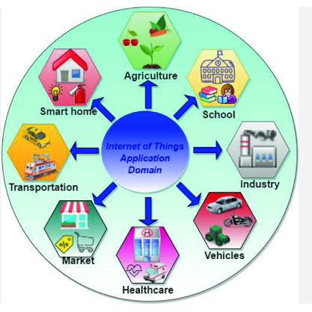
Discussion and Results
The section unfolds detailed findings on application layer protocols, dissecting their functionality, efficiency, security, and scalability.
Functional analysis examines the design and operational nuances of each protocol within network communication.
HTTP's evolution analyzed beyond content delivery to support complex web app interactions with methods like PUT and DELETE (Kirvan, 2021).
Explores FTP's command and data channel structure, impacting its functionality in modern network design.
Discusses SMTP's streamlined yet robust mechanisms for email queuing, relaying, and delivery (Kirvan, 2021).

Slide 12
Codes Examples
Several code snippets have been provided to illustrate these functionalities and complement the discussion. For instance:
# Python snippet for an HTTP GET request using the requests library
import requests
def fetch_webpage(url):
response = requests.get(url)
return response.content if response.status_code == 200 else None
webpage_data = fetch_webpage('http://www.example.com')

Slide 13
Codes Example
In this snippet, the simplicity of performing an HTTP GET request in Python demonstrates HTTP's ease of use for web content retrieval, a foundational functionality of the protocol.
# Python snippet for an FTP file download using the ftplib library
from ftplib import FTP
def download_file(ftp_server, username, password, remote_path, local_path):
ftp = FTP(ftp_server)
ftp.login(user=username, passwd=password)
with open(local_path, 'wb') as local_file:
ftp.retrbinary('RETR ' + remote_path, local_file.write)
ftp.quit()
download_file('ftp.example.com', 'user123', 'password', '/path/to/remote/file', 'downloaded_file.txt')

Slide 14
Codes Example
This snippet highlights the process of logging into an FTP server and downloading a file, showcasing the protocol's role in file management tasks.
# Python snippet for sending an email using the smtplib library
import smtplib
from email.mime.text import MIMEText
def send_email(smtp_server, port, username, password, sender, receiver, subject, body):
msg = MIMEText(body)
msg['Subject'] = subject
msg['From'] = sender
msg['To'] = receiver
with smtplib.SMTP(smtp_server, port) as server:
server.starttls()
server.login(username, password)
server.sendmail(sender, [receiver], msg.as_string())
send_email('smtp.example.com', 587, 'user123', 'password', 'sender@example.com', 'receiver@example.com', 'Test Subject', 'This is the email body.')

Slide 15
Comparative Evaluation of Protocol Performance
Analysis evaluates protocols based on efficiency, security, and scalability in network performance.
HTTP/2's binary framing shows increased web transfer efficiency over text-based HTTP/1.1.
FTP remains robust in file transfer but falls behind SFTP in security enhancements.
SMTP excels in email efficiency but requires protocols like DMARC and STARTTLS for scaling and security (Gupta, 2022).

Slide 16
Conclusion
HTTP/2’s multiplexing capabilities improve speed and reduce resource use, outperforming HTTP/1.1.
Security assessments reveal weaknesses in protocols like FTP, highlighting the need for secure variants such as FTPS.
Scalability limitations in SMTP are managed through complex strategies in large-scale systems (Gupta, 2022).
Concludes that protocols serve distinct roles and that continued innovation and context-aware deployment are crucial for advancement.

Slide 17
References
Kirvan, P. (2021). What is Application layer? - Definition from WhatIs.com. SearchNetworking. https://www.techtarget.com/searchnetworking/definition/Application-layer
Lisa, P. (2023, December 11). What Is SMTP? Understanding the Simple Mail Transfer Protocol. MonoVM.com. https://monovm.com/blog/smtp/
Vadapalli, P. (2024, March 2). Application Layer Tutorial Sub Topic. Www.upgrad.com. https://www.upgrad.com/tutorials/software-engineering/software-key-tutorial/application-layer/
Walden, H. (2022, March 16). What is Cornerstone Content and Why is it So Important? Elegant Themes Blog. https://www.elegantthemes.com/blog/wordpress/what-is-cornerstone-content-and-why-is-it-so-important
Yadav, H. (2023, February 21). Application Layer Protocols in Computer Networks. PrepBytes Blog. https://www.prepbytes.com/blog/computer-network/application-layer-protocols-in-computer-networks/#:~:text=Answer%3A%20The%20purpose%20of%20Application
Ayman, O. (2019). Analysis of Application Layer Protocols Used in Internet of Things. SSRN Electronic Journal. https://doi.org/10.2139/ssrn.3810913
Domantas, G. (2018, December 19). What is FTP: File transfer protocol explained for beginners. Hostinger Tutorials. https://www.hostinger.com/tutorials/what-is-ftp
Gupta, S. (2022, October 29). Application Layer Protocols in Computer Network. Scaler Topics. https://www.scaler.com/topics/computer-network/application-layer-protocols/
InfosecTrain. (2023, September 13). What is Application Layer in OSI Model? Medium. https://medium.com/@Infosec-Train/what-is-application-layer-in-osi-model-4a68704294f9
Kerner, S. M. (2021, May). What Is FTP? File Transfer Protocol explained. SearchNetworking. https://www.techtarget.com/searchnetworking/definition/File-Transfer-Protocol-FTP

